Slide 1
LOAN ELIGIBITLIY PREDICTION ANALYSIS
- Derrie Susan Varghese
- Varun Jagadeesh
- Vivek Garimella

Slide 2


CONTENTS:
Description
Dataset Overview
Exploratory Data Analysis
Approach
Data Preprocessing
Modelling
Results Comparison

Slide 3

DESCRIPTION:
Loans are approved after considering various factors such as credit score, income.
Predict loan eligibility from the past records.

Slide 4
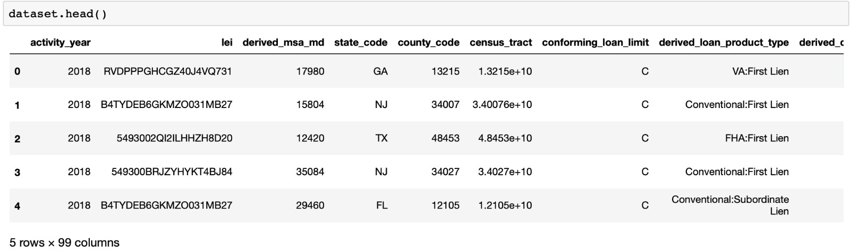
DATA SET overview
National Level Loan Dataset – collected by the Federal Financial Institutions Examination Council (FFEIC) under the Home Mortgage Disclosure Act (HMDA) for the year 2018.
The dataset consists of about 15 million datapoints and 99 features such as loan amount ,loan term ,property value, action taken

Slide 5
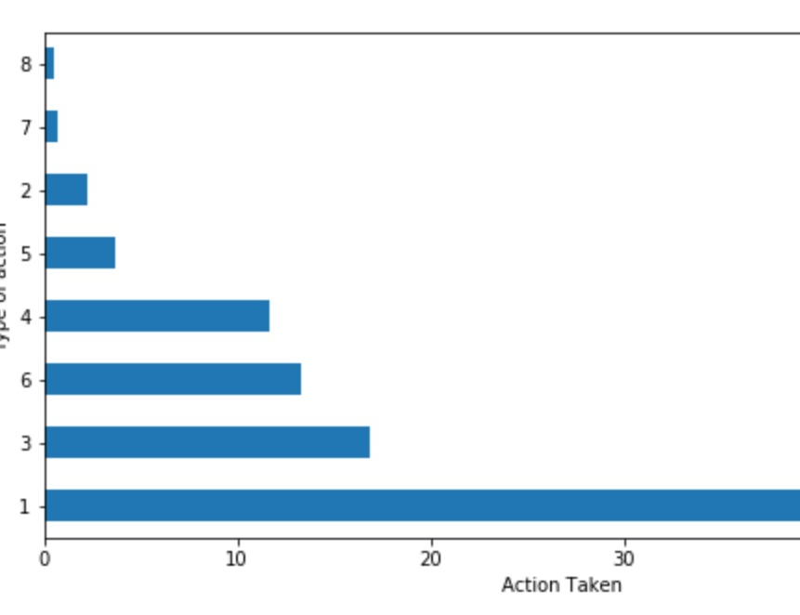
Target variable
1 - Loan originated
2 - Application approved but not accepted
3 - Application denied
4 - Application withdrawn by applicant
5 - File closed for incompleteness
6 - Purchased loan
7 - Preapproval request denied
8 - Preapproval request approved but not accepted
3,7 – Loan Denied
1,2 – Loan Approved

Slide 6
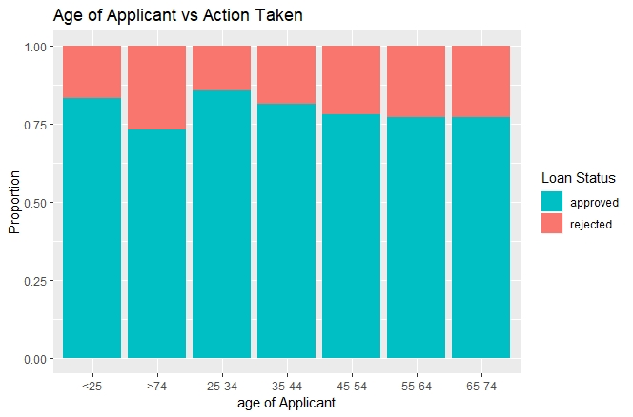
EXPLORATORY DATA ANALYSIS:
Age of applicant vs Action taken

Slide 7
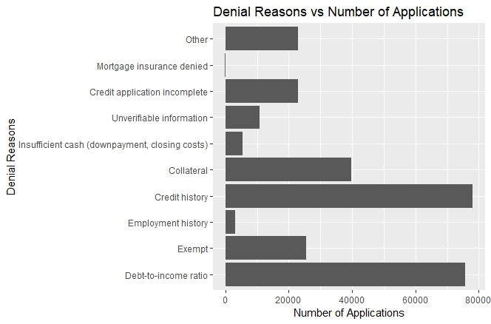
EXPLORATORY DATA ANALYSIS:
Number of applications per denial reason

Slide 8
EXPLORATORY DATA ANALYSIS:
Applicant’s income to debt ratio vs Action taken

Slide 9
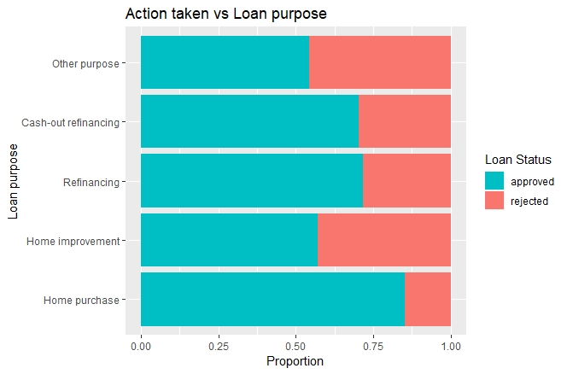
EXPLORATORY DATA ANALYSIS:
Loan purpose vs Action taken

Slide 10
Data Preprocessing
Feature Selection:
Huge dataset – 15M data points and 99 columns
Columns with missing values > 90% were removed (about 30)
Sampled the data multiple times and evaluated
Random Forest - Feature importance
Dropped the columns which were dependent on target variable (interest rate)
One hot encoded categorical variables
Number of Features selected - 48
Cleaned data was stored in as a new csv file and was used in model building

Slide 11
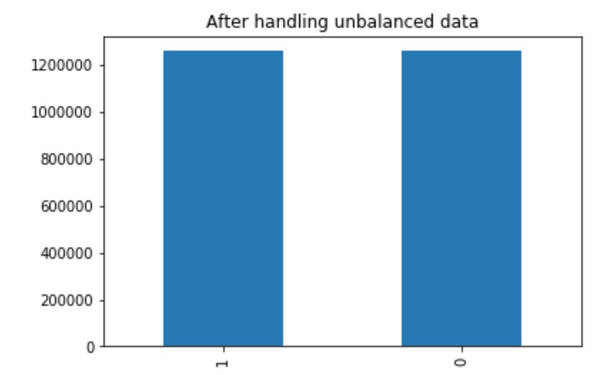
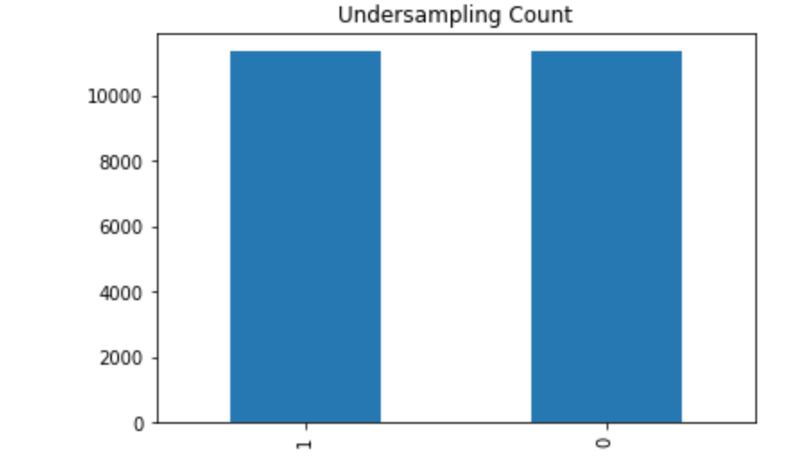
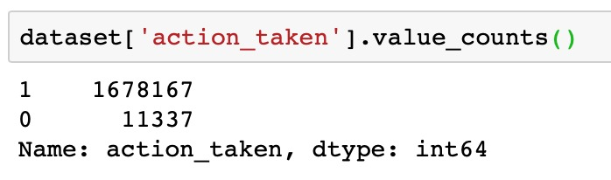
Imbalanced data handling
Percentage of 1’s – 99.932 %
Percentage of 0’s – 00.068 %
Data is highly imbalanced
Lead to incorrect results during modeling
Performed over sampling and under sampling in order to handle imbalanced data
Evaluated on both samples

Slide 12
Feature importance
Random Forest
Lasso
Aus1
Applicant_credit_score_type
Purchaser_type
Loan_term
Income
Purchaser_type
Property_value
Loan_type
Loan_term
aus_1
Applicant_credit_score_type

Slide 13
MODELS IMPLEMENTED:
Logistic Regression
Random Forests
Naïve Bayes Classifier
XG Boost
ADA Boost Classifier
LDA

Slide 14
EVALUATION - Accuracy
Model | Oversampling Accuracy | Under sampling Accuracy
Ada Boost | 99.110981 | 98.041982
Random Forest | 99.112165 | 98.430058
LDA | 95.807763 | 97.989063
Logistic Regression | 96.812792 | 98.200741
Naïve Bayes | 96.963369 | 97.442229
XGBoost | 97.812138 | 98.482977
Accuracy is not a good metric for imbalanced data

Slide 15
EVALUATION - Precision
 | Random Forest |  | Logistic Regression |  | Naïve Bayes |  | LDA |  | XG Boost |  | ADABoost
 | 0 | 1 | 0 | 1 | 0 | 1 | 0 | 1 | 0 | 1 | 0 | 1
Over Sampling | 0.337 | 0.995 | 0.173 | 0.999 | 0.179 | 0.999 | 0.137 | 0.999 | 0.218 | 0.998 | 0.326 | 0.995
Under Sampling | 0.979 | 0.999 | 0.966 | 0.998 | 0.951 | 0.976 | 0.961 | 0.998 | 0.97 | 1 | 0.966 | 0.994

Slide 16
Evaluation – recall
 | Random Forest |  | Logistic Regression |  | Naïve Bayes |  | LDA |  | XG Boost |  | ADABoost
 | 0 | 1 | 0 | 1 | 0 | 1 | 0 | 1 | 0 | 1 | 0 | 1
Over Sampling | 0.299 | 0.996 | 0.998 | 0.968 | 0.973 | 0.970 | 0.998 | 0.958 | 0.851 | 0.979 | 0.294 | 0.995
Under Sampling | 0.999 | 0.969 | 0.998 | 0.966 | 0.976 | 0.972 | 0.998 | 0.961 | 1.0 | 0.970 | 0.964 | 0.966

Slide 17
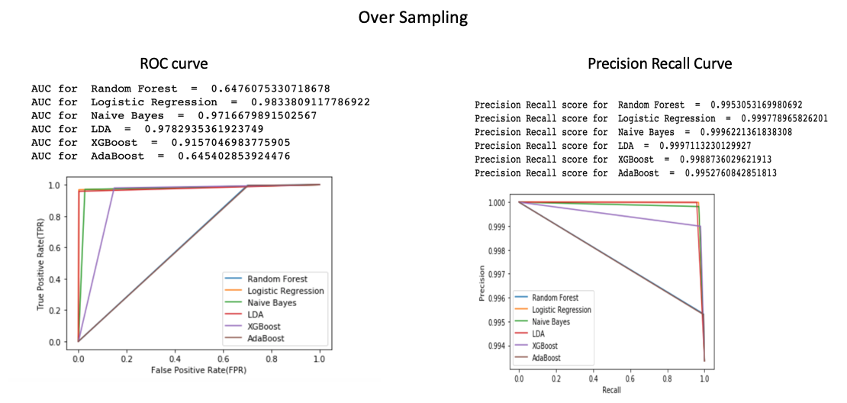
ROC and PRECISION-RECALL CURVE
ROC Curve is not a good metric for imbalanced data

Slide 18
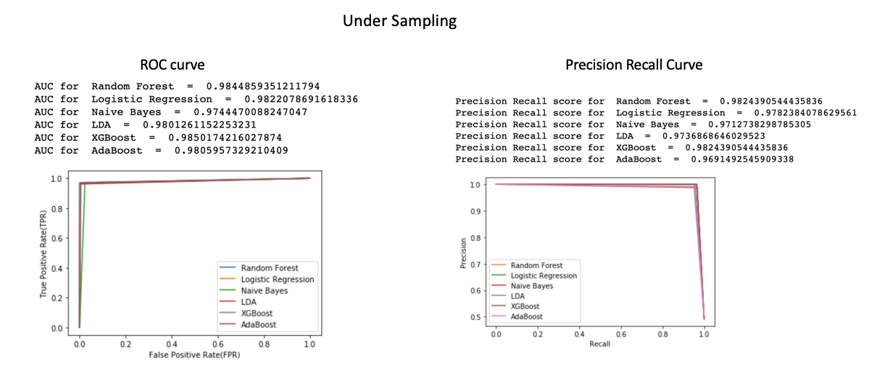
ROC and PRECISION-RECALL CURVE
ROC Curve is not a good metric for imbalanced data

Slide 19
CONCLUSION
Random Forest is performing the best.
Naïve Bayes performed the worst.
FUTURE WORK
Impute values instead of removing null values.
Use the entire dataset instead of sampling.
Perform different ratios in SMOTE and evaluate performance.
Perform cross-validation.

Slide 20

Thank you

